Slide 1
Allocation of memory
Remember that memory is a 1D array of machine units
So:
32 bits → 4 byte alignment
64 bits → 8 byte alignment
i.e. the smallest “thing” you can allocate is whatever your “word size” is. Want a char (1 byte)? Too bad, you get 8 bytes.

Slide 2
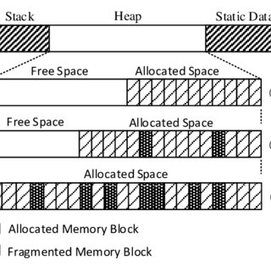
Over time, there is fragmentation
From: https://www.google.com/url?sa=i&url=https%3A%2F%2Fwww.researchgate.net%2Ffigure%2FSystem-memory-in-different-time-instances-with-diverse-fragmentation-states-as-dynamic_fig1_305333536&psig=AOvVaw3pyd-IM6KYpeJJY5qZV1dU&ust=1709650960718000&source=images&cd=vfe&opi=89978449&ved=0CBMQjRxqFwoTCPj2laLw2oQDFQAAAAAdAAAAABAE

Slide 3
Fragmentation
As memory (objects) are allocated and deallocated (deleted), the memory gets fragmented.
This happens on both the stack and heap, though the stack has the advantage that it grows and shrinks, so fragmentation is less of a problem BUT you have other issues like stack size (think array size, etc.)
AND almost everything you really allocate is on the heap:
stl vector, list, etc. – The “vector” is on the stack, but all the data is on the heap.
Even something like push_back, or especially insert() on a list or doing anything a map, you’ll run into fragmentation

Slide 4
Fragmentation
Couple issues:
What’s allocated and what’s not: Finding an initial stop on the heap that isn’t used or freed up. Almost always a linear scan from the start
Even then, new() is allocating things that are all different sizes:
…new int(), …new cMesh(), etc.
This complicates things
AND what if you allocate something really “large” like an array of things?
New() is clever, but potentially slow
(Also, it’s just malloc() underneath it all)

Slide 5
Avoiding Fragmentation: “solution”
Allocate a large block of memory for whatever thing you are using.
If there’s multiple types of things:
Allocate a region for each one.
YOU are “on the hook” to manage that.
“new” and “delete” aren’t really creating/deleting
You can manage this yourself – think “particle emitter” does this
You can overload the new operator
BE VERY CAREFUL with this

Slide 6
Avoiding Fragmentation: “solution”
Allocate a large block of memory for whatever thing you are using.
If there’s multiple types of things:
Allocate a region for each one.
YOU are “on the hook” to manage that.
“new” and “delete” aren’t really creating/deleting

